Slide 1
Video ad
ABCD - Attention, Branding, Connection, Direction
The video ad seems to be created for Awareness stage, since the music is loud, to catch people’s attention, brand is in front from the first seconds and people are core of the story.

Slide 2
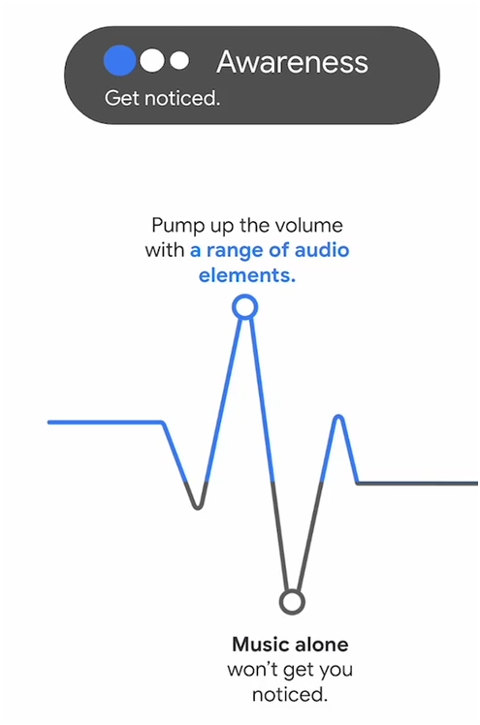
A - Attention
The video is fast paced, engaging and the music catches the attention from the beginning.
Even though music is hooking, yet there’s not enough of other sound effects.
But that’s just a note, in my opinion sound effects might help, but that’s not a crucial mistake to not include them in this case.

Slide 3
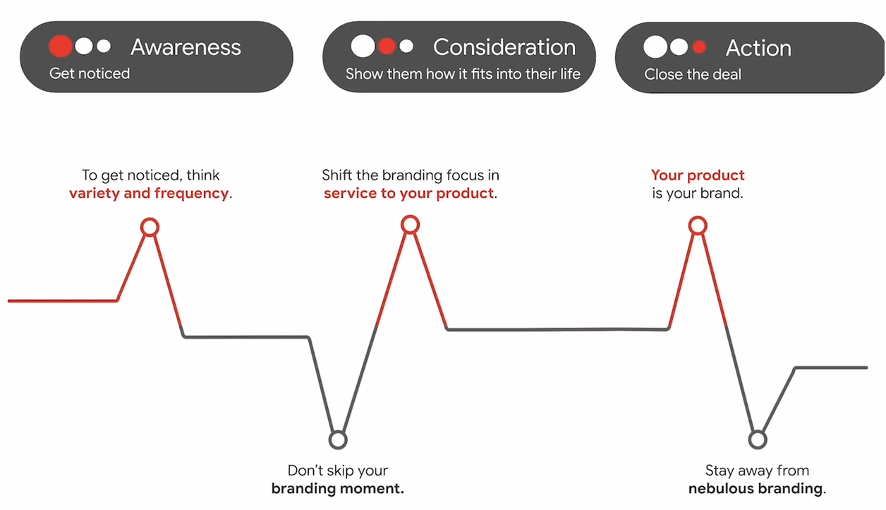
B - Branding
Brand name and brand logo is shown straight away, the typography is consistent and in some scenes the brand name is visible on the products.
One small mistake might be that a lot of products are being showcased throughout the video, that might indicate Consideration/Action phase.
So quick fix would be to have brand logo/name in a corner throughout the whole video.

Slide 4
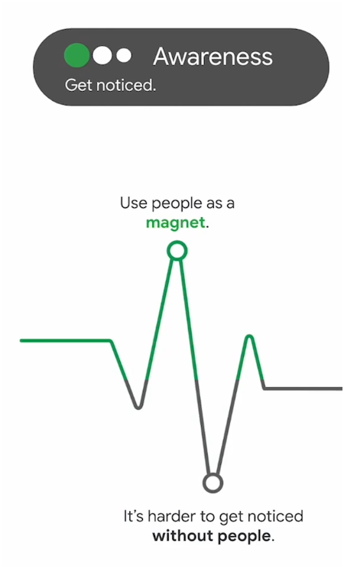
C - Connection
Whole video shows people in it, especially for clothes that’s even better, it’s shown how the clothes look like on people.
Not only that we can see their social media accounts, that might build even more trust, especially for new brands.
Even the video looks warm and welcoming, no mistakes here.

Slide 5
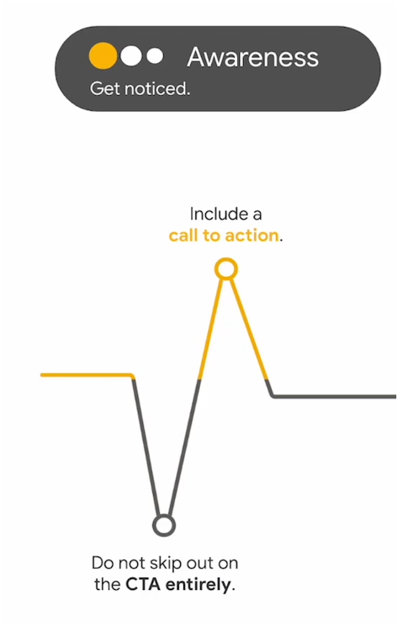

D - Direction
CTA is included and it doesn’t have to be as specific as “Buy Now” “Get Now”, so this one fits the criteria for Awareness stage, it could be shown for 1-2s longer in the video.

Slide 6
Business objectives:
Increase brand awareness by reaching 5mil unique viewers within 1 year.
Marketing objectives:
20% brand lift increase within 6 months
Maintain 10% engagement rate throughout 6 months
Campaign goal:
Reach 500 000 unique viewers within 1 month with Youtube ads
Reach 10% engagement rate within 1 month with Youtube ads

Slide 7
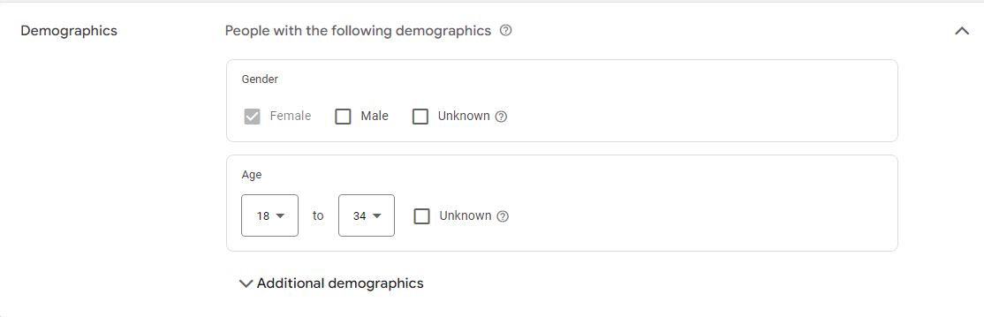
Since jeans in the ad showcase females only, that will be our target audience. And biggest shoppers for fashion are 18-34 year olds, so I’ve created an audience for this ad just by demographics:
Females - 18-34 year olds.

Slide 8
For the video Ad I went with Target CPV (0.05EUR) bid strategy.
Daily budget 100 EUR (hypothetical). Location: All countries
CTA - Shop now
Long headline: Find your perfect fit with Hollister jeans – stylish, comfortable, and made for you!
Description: Stylish, comfy jeans for any occasion. Discover your perfect pair at Hollister today!

Slide 9
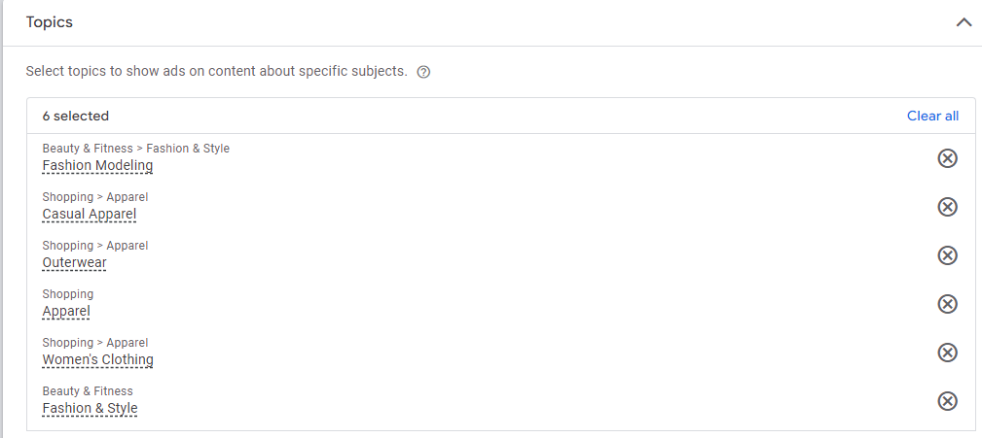
I’ve added 6 related topics to slightly narrow the audience, even if our goal is Awareness, there’s no need to show the ad for absolutely everyone

Slide 10
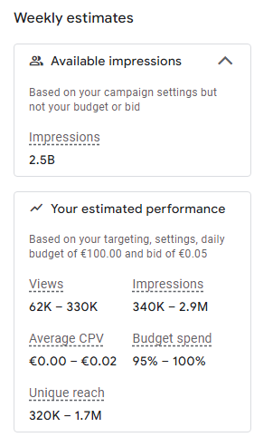
After setting up the ad campaign, that’s the estimated results that I’ve got
The Campaign goal was to reach 500 000 unique viewers, and with this campaign it’s totally possible, we will have to track the engagement rate as the ad ramps up.

